Slide 1
UPPER SIXTH ARTS
GEOGRAPHY
Quantitative Techniques 3
Basic Tools of Data Analysis
Notes:
Good morning, class, and welcome to our geography lesson. I am your geography teacher, Mr Kamdem. Today we are starting Quantitative Techniques 3: Basic Tools of Data Analysis.

Slide 2
CLASS INFO
Class, Chapter and Duration
Class | Upper Sixth Arts
Chapter | Module 8: Understanding and carrying out statistical techniques, topographic map analysis, fieldwork and project based learning
Duration | 2 periods (2 × 50 minutes)
Notes:
This lesson is for Upper Sixth Arts. It belongs to Module 8: Understanding and carrying out statistical techniques, topographic map analysis, fieldwork and project based learning. We shall need 2 periods to cover it.

Slide 3
IDENTIFICATION
Lesson Identification
Topic | Quantitative Techniques in Geography
Sub-topic | Statistical Techniques
Lesson | Quantitative Techniques 3: Basic Tools of Data Analysis
Notions / Concepts | Mean, median, mode, range, quartile, interquartile range, variance, standard deviation, coefficient of variation, Spearman's rank correlation.
Syllabus focus | Measures of central tendency (mean, median, mode, range, quartiles, IQR); dispersion (variance, standard deviation, coefficient of variation); association (Spearman's rank correlation).
Competence | Learners are able to calculate and interpret basic statistics for geographical data.
Notes:
Our topic is Quantitative Techniques in Geography, and the sub-topic is Statistical Techniques. The key notions we shall use today are: mean, median, mode, range, quartile, interquartile range, variance, standard deviation, coefficient of variation, Spearman's rank correlation. At the end, you should be able to do this: learners are able to calculate and interpret basic statistics for geographical data.

Slide 4

HOMEWORK CORRECTION
Correction of the Homework
Question (Quantitative Techniques 2: Data Collection: Sources and Techniques):
Prepare a questionnaire of five questions about how students travel to school.
Notes:
Before we start the new lesson, let us correct the homework I gave you at the end of Quantitative Techniques 2: Data Collection: Sources and Techniques. The question was: Prepare a questionnaire of five questions about how students travel to school. Take out your exercise books.

Slide 5
HOMEWORK CORRECTION
Correction: Possible Answer
Example: 1. Which class are you in? 2. How do you come to school (foot, bike, moto-taxi, car)? 3. How far do you live (km)? 4. How long does the trip take? 5. What problem do you meet on the way?
Notes:
Here is a good answer. Example: 1. Which class are you in? 2. How do you come to school (foot, bike, moto-taxi, car)? 3. How far do you live (km)? 4. How long does the trip take? 5. What problem do you meet on the way? Compare it with your own answer and correct your work in red.

Slide 6
LESSON PLAN
Lesson Plan
Correction of the homework
Objectives and recall
Real-life situation and action to take
Learning activities
Board summary
Evaluation, remediation and homework
Notes:
Here is the plan of our lesson today. First, we shall correct the homework. Then we shall look at the objectives and recall what you already know. After that, we shall study a situation from real life and the action to take, and do the learning activities. Finally, we shall copy the board summary, do the evaluation and the remediation, and I will give you the homework.

Slide 7
OBJECTIVES
Objectives
By the end of this lesson, you should be able to:
Calculate the mean, median, mode, range and interquartile range.
Calculate the standard deviation and coefficient of variation.
Notes:
Take your time to copy this part; we will continue together.

Slide 8
OBJECTIVES
Objectives (continued)
Calculate and interpret Spearman's rank correlation.
Notes:
By the end of this lesson, you should be able to do three things. Number 1: calculate the mean, median, mode, range and interquartile range. Number 2: calculate the standard deviation and coefficient of variation. Number 3: calculate and interpret Spearman's rank correlation.

Slide 9
PREVIOUS KNOWLEDGE
Previous Knowledge
An average summarises many values.
Data can be ranked from highest to lowest.
Notes:
Let us first remember what you already know. An average summarises many values. Data can be ranked from highest to lowest. Keep this in mind, because we shall build on it today.

Slide 10
REAL-LIFE SITUATION
Situation in Real Life
The class has the monthly rainfall of a station and the population and number of services of six towns. They must summarise the rainfall and test whether bigger towns have more services.
Notes:
Listen carefully to this situation from real life. The class has the monthly rainfall of a station and the population and number of services of six towns. They must summarise the rainfall and test whether bigger towns have more services. Think about it, because I am going to ask you some questions.

Slide 11
REAL-LIFE SITUATION
Situation: Question 1
What is the problem in the situation?
Notes:
Question 1: What is the problem in the situation? Think for a moment, then raise your hand to answer.

Slide 12
REAL-LIFE SITUATION
Answer
The class must summarise and compare data.
Notes:
Good. The class must summarise and compare data.

Slide 13
REAL-LIFE SITUATION
Situation: Question 2
Which measure gives the average?
Notes:
Question 2: Which measure gives the average? Think for a moment, then raise your hand to answer.

Slide 14
REAL-LIFE SITUATION
Answer
The mean (or median).
Notes:
Good. The mean (or median).

Slide 15
REAL-LIFE SITUATION
Situation: Question 3
Which test compares two rankings?
Notes:
Question 3: Which test compares two rankings? Think for a moment, then raise your hand to answer.

Slide 16
REAL-LIFE SITUATION
Possible Answer
Spearman's rank correlation.
Notes:
Good. Spearman's rank correlation.

Slide 17
ACTION TO TAKE
Action to Take
Support every geographical conclusion with correct statistics.
Notes:
From this situation, the action we are working towards in this lesson is the following: support every geographical conclusion with correct statistics.

Slide 18
JUSTIFICATION
Justification of the Lesson
This lesson gives us the statistical tools to analyse geographical data.
Notes:
Why is this lesson important for you? This lesson gives us the statistical tools to analyse geographical data.

Slide 19
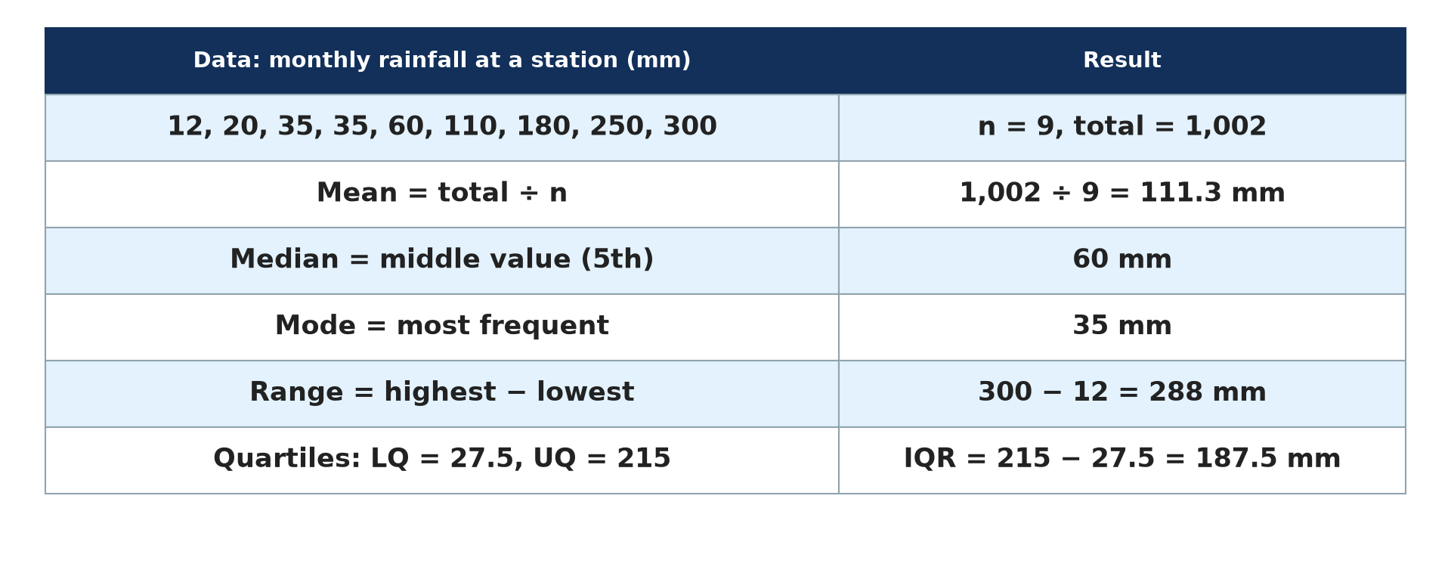
1. CENTRAL TENDENCY
Activity 1
Mean, median, mode and range.
Notes:
Activity 1. Look carefully at this diagram: mean, median, mode and range. Observe every detail before I ask the question.

Slide 20
1. CENTRAL TENDENCY
Activity 1: Question
Why is the median sometimes better than the mean?
Notes:
Here is the question for Activity 1: Why is the median sometimes better than the mean? Take one minute to think and write your answer in your rough notebook.

Slide 21
1. CENTRAL TENDENCY
Activity 1: Answer
It is not affected by extreme values.
Notes:
Let us check the answer together. It is not affected by extreme values.

Slide 22
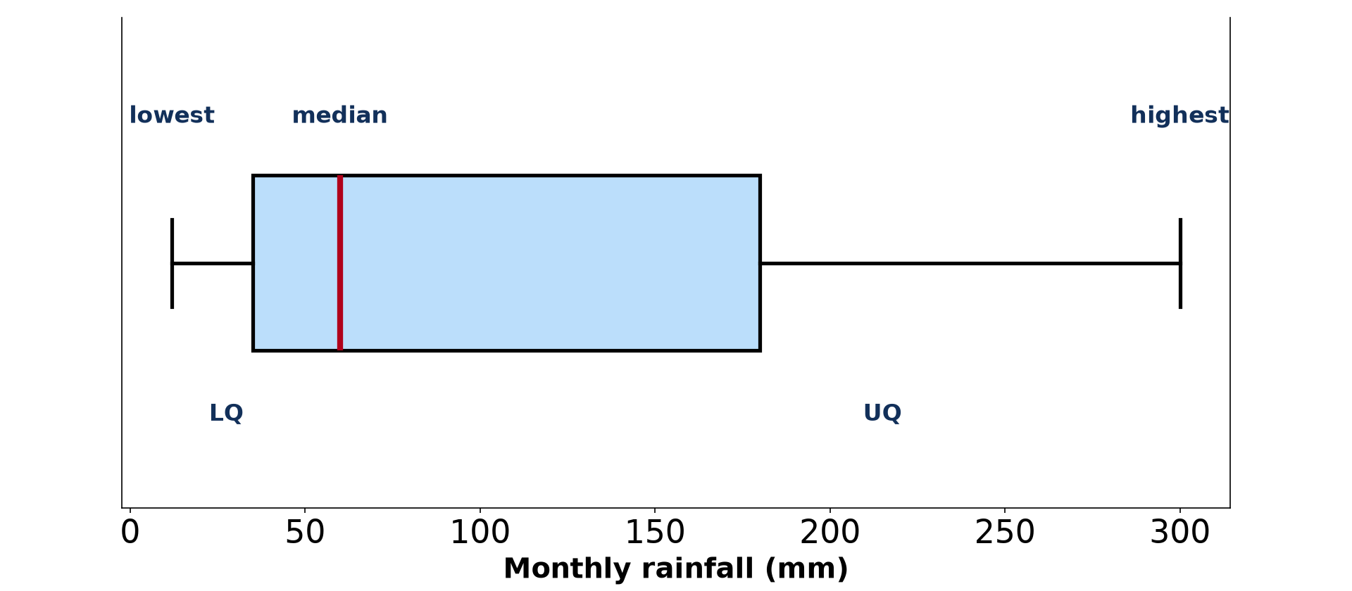
1. QUARTILES
Activity 2
Box-and-whisker plot.
Notes:
Activity 2. Look carefully at this diagram: box-and-whisker plot. Observe every detail before I ask the question.

Slide 23
1. QUARTILES
Activity 2: Question
What does the interquartile range show?
Notes:
Here is the question for Activity 2: What does the interquartile range show? Take one minute to think and write your answer in your rough notebook.

Slide 24
1. QUARTILES
Activity 2: Answer
The spread of the middle half of the data.
Notes:
Let us check the answer together. The spread of the middle half of the data.

Slide 25
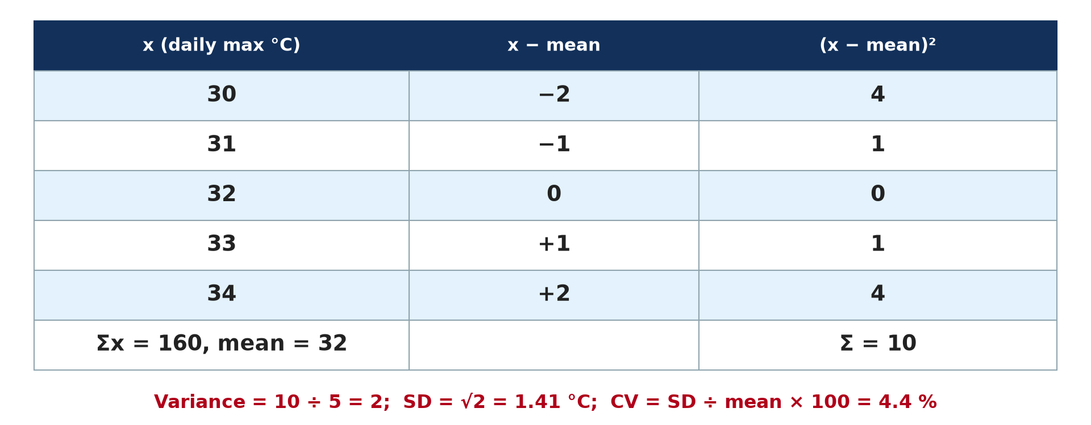
2. DISPERSION
Activity 3
Standard deviation worked example.
Notes:
Activity 3. Look carefully at this diagram: standard deviation worked example. Observe every detail before I ask the question.

Slide 26
2. DISPERSION
Activity 3: Question
What does a small standard deviation mean?
Notes:
Here is the question for Activity 3: What does a small standard deviation mean? Take one minute to think and write your answer in your rough notebook.

Slide 27
2. DISPERSION
Activity 3: Answer
The values are close to the mean (little variation).
Notes:
Let us check the answer together. The values are close to the mean (little variation).

Slide 28
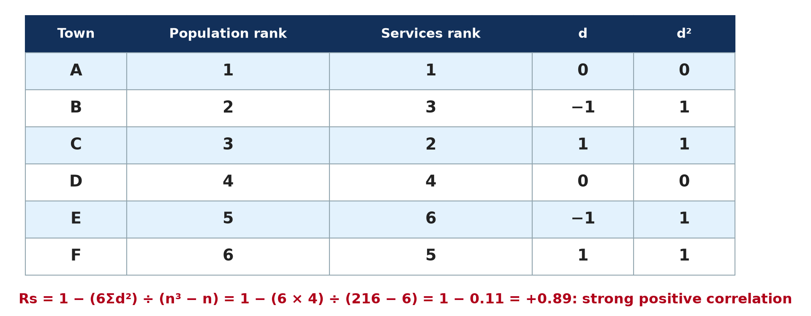
3. SPEARMAN'S RANK
Activity 4
Spearman's rank correlation.
Notes:
Activity 4. Look carefully at this diagram: spearman's rank correlation. Observe every detail before I ask the question.

Slide 29
3. SPEARMAN'S RANK
Activity 4: Question
Interpret Rs = +0.89.
Notes:
Here is the question for Activity 4: Interpret Rs = +0.89. Take one minute to think and write your answer in your rough notebook.

Slide 30
3. SPEARMAN'S RANK
Activity 4: Answer
A strong positive correlation: bigger towns have more services.
Notes:
Let us check the answer together. A strong positive correlation: bigger towns have more services.

Slide 31
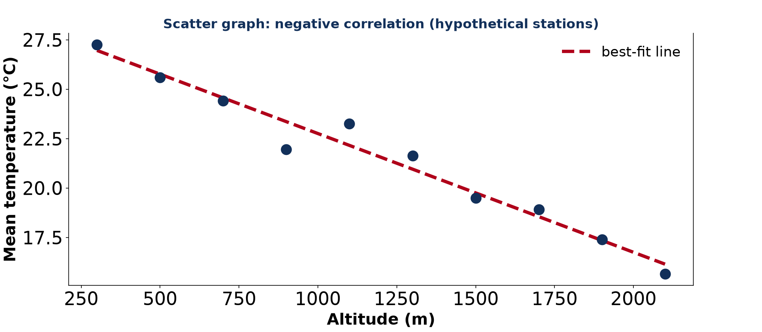
3. SIGNIFICANCE
Activity 5
A negative correlation.
Notes:
Activity 5. Look carefully at this diagram: a negative correlation. Observe every detail before I ask the question.

Slide 32
3. SIGNIFICANCE
Activity 5: Question
What would Rs close to −1 mean?
Notes:
Here is the question for Activity 5: What would Rs close to −1 mean? Take one minute to think and write your answer in your rough notebook.

Slide 33
3. SIGNIFICANCE
Activity 5: Answer
A strong negative correlation: as one value rises, the other falls.
Notes:
Let us check the answer together. A strong negative correlation: as one value rises, the other falls.

Slide 34
BOARD SUMMARY
Board Summary
Topic: Quantitative Techniques in Geography
Sub-topic: Statistical Techniques
Quantitative Techniques 3: Basic Tools of Data Analysis
Notes:
Now we are going to copy the board summary. Write the title and the headings neatly in your notebooks. I will give you enough time for each slide, so do not rush.

Slide 35
BOARD SUMMARY
1. Measures of Central Tendency
The centre of a data set is measured as follows:
Mean, median and mode: The mean is the sum of values divided by their number, and the median is the middle value. The mode is the most frequent value.
Notes:
Let us copy Measures of Central Tendency. The centre of a data set is measured as follows. On this slide we have Mean, median and mode. Write each point on a new line, with the key term first, and explain it in your own words when we revise. When you finish, we go to the next slide.

Slide 36
BOARD SUMMARY
1. Measures of Central Tendency (continued)
Range, quartiles and IQR: The range is the highest minus the lowest value. The interquartile range (Q3 − Q1) shows the spread of the middle half and is not affected by extremes.
Notes:
We continue with Measures of Central Tendency. On this slide we have Range, quartiles and IQR. Write each point on a new line, with the key term first, and explain it in your own words when we revise.

Slide 37
BOARD SUMMARY
1. Measures of Central Tendency
Illustration: box-and-whisker plot
Notes:
Now draw this illustration in your notebook: box-and-whisker plot. Give it a title and label it clearly.

Slide 38
BOARD SUMMARY
2. Measures of Dispersion
The spread of data is measured as follows:
Variance and standard deviation: The standard deviation is the square root of the mean of squared deviations from the mean. A small value shows that the data are close to the mean.
Notes:
Let us copy Measures of Dispersion. The spread of data is measured as follows. On this slide we have Variance and standard deviation. Write each point on a new line, with the key term first, and explain it in your own words when we revise. When you finish, we go to the next slide.

Slide 39
BOARD SUMMARY
2. Measures of Dispersion (continued)
Coefficient of variation: It is the standard deviation divided by the mean, times 100. It compares the variability of data sets with different means.
Notes:
We continue with Measures of Dispersion. On this slide we have Coefficient of variation. Write each point on a new line, with the key term first, and explain it in your own words when we revise.

Slide 40
BOARD SUMMARY
2. Measures of Dispersion
Illustration: standard deviation worked example
Notes:
Now draw this illustration in your notebook: standard deviation worked example. Give it a title and label it clearly.

Slide 41
BOARD SUMMARY
3. Spearman's Rank Correlation
The relationship between two variables is measured as follows:
Formula: Rs = 1 − (6Σd²) ÷ (n³ − n), where d is the difference in ranks. The result lies between −1 and +1.
Notes:
Let us copy Spearman's Rank Correlation. The relationship between two variables is measured as follows. On this slide we have Formula. Write each point on a new line, with the key term first, and explain it in your own words when we revise. When you finish, we go to the next slide.

Slide 42
BOARD SUMMARY
3. Spearman's Rank Correlation (continued)
Interpretation: Values near +1 show a strong positive correlation and values near −1 a strong negative one. Significance tables tell whether the result could be due to chance.
Notes:
We continue with Spearman's Rank Correlation. On this slide we have Interpretation. Write each point on a new line, with the key term first, and explain it in your own words when we revise.

Slide 43
BOARD SUMMARY
3. Spearman's Rank Correlation
Illustration: Spearman's rank worked example
Notes:
Now draw this illustration in your notebook: spearman's rank worked example. Give it a title and label it clearly.

Slide 44
FORMATIVE EVALUATION
Evaluation 1
Find the mean and median of 4, 8, 10, 12, 26.
Notes:
Now let us check what you have understood. Question 1: Find the mean and median of 4, 8, 10, 12, 26. Answer in your exercise book.

Slide 45
FORMATIVE EVALUATION
Expected Answer
Mean = 60 ÷ 5 = 12; median = 10.
Notes:
The expected answer is: mean = 60 ÷ 5 = 12; median = 10. If you got it right, well done.

Slide 46
FORMATIVE EVALUATION
Evaluation 2
n = 6, Σd² = 10. Find Rs.
Notes:
Now let us check what you have understood. Question 2: n = 6, Σd² = 10. Find Rs. Answer in your exercise book.

Slide 47
FORMATIVE EVALUATION
Expected Answer
1 − 60 ÷ 210 = 0.71: fairly strong positive.
Notes:
The expected answer is: 1 − 60 ÷ 210 = 0.71: fairly strong positive. If you got it right, well done.

Slide 48
REMEDIATION
Remediation
Fill in the blanks:
The middle value is the ______.
UQ − LQ is the ______ range.
Rs lies between −1 and ______.
Notes:
For those who need more practice, fill in the blanks in your exercise book. The answers are: number 1, median; number 2, interquartile; number 3, +1.

Slide 49
HOMEWORK
Homework
Collect the daily maximum temperature for 7 days and calculate the mean and standard deviation.
Notes:
For your homework: Collect the daily maximum temperature for 7 days and calculate the mean and standard deviation. We shall correct it at the beginning of our next lesson.

Slide 50
NEXT LESSON
Next Lesson
Our next lesson will be on:
Quantitative Techniques 4: Plotting and Interpreting Graphical Tools
Notes:
Our next lesson will be on Quantitative Techniques 4: Plotting and Interpreting Graphical Tools. Thank you for your attention, and see you next time.

Slide 51
BILINGUAL GAME
Bilingual Game (Jeu Bilingue)
English | Français
Mean | La moyenne
Median | La médiane
Mode | Le mode
Range | L'étendue
Standard deviation | L'écart type
Correlation | La corrélation
Notes:
Let us play the bilingual game. I say a word in English, and you give me the French word. Then we do the reverse.

Slide 52
LOGBOOK
Official Logbook (1/2)
Module / Topic | Quantitative Techniques in Geography
Lesson Title | Quantitative Techniques 3: Basic Tools of Data Analysis
Expected Learning Outcomes | Calculate the mean, median, mode, range and interquartile range. Calculate the standard deviation and coefficient of variation. Calculate and interpret Spearman's rank correlation.
Competence | Learners are able to calculate and interpret basic statistics for geographical data.
Notes:
I record this information in the official logbook of the class after the lesson.

Slide 53
LOGBOOK
Official Logbook (2/2)
Matter Taught | Measures of Central Tendency; Measures of Dispersion; Spearman's Rank Correlation.
Evaluation | Formative evaluation and remediation exercise.
Homework | Collect the daily maximum temperature for 7 days and calculate the mean and standard deviation.
Enrolment / Present / Absent | ____ / ____ / ____
Achievement | To be completed after the lesson.
Notes:
I complete the second page of the logbook: the matter taught, the evaluation, the homework and the attendance.

Slide 54
TEACHER'S NOTE
Teacher's Note
Timing: Homework correction, plan, objectives 8 min | Recall, situation, action 10 min | 5 activities 30 min | Board summary (copying) 30 min | Evaluation, remediation 10 min | Homework, next lesson 5 min | Logbook 7 min
Without the projector (Activity 1): calculate each measure.
Without the projector (Activity 2): find LQ and UQ.
Without the projector (Activity 3): complete the table.
Without the projector (Activity 4): rank the data.
Without the projector (Activity 5): describe the graph.
Notes:
This slide is for me, the teacher: it gives the timing of the lesson and what to do if the projector is not available.

Slide 55
REFERENCES
References
National Geography Syllabus, MINESEC/IGE/IP-SS, 2019 — Module 8 (Practical Geography).
Diagrams and animations: drawn for this lesson (Geography Department).
Notes:
These are the references and picture credits used to prepare this lesson.

